Slide 1
Directed Acyclic Graph
Undershorts
Socks
Watch
Pant
Shoes
Shirt
Belt
Tie
Jacket
Socks
Undershorts
Pant
Shoes
watch
Shirt
Belt
Tie
Jacket

Slide 2
Start and Finish Times applied
Undershorts
11/16
Socks
17/18
Watch
12/15
Pant
Shoes
13/14
9/10
Shirt
1/8
6/7
Belt
Tie
2/5
Jacket
3/4
Socks
Undershorts
Pant
Shoes
watch
Shirt
Belt
Tie
Jacket
17/18
11/16
12/15
13/14
9/10
1/8
6/7
2/5
3/4

Slide 3
Prove if edge from u to v in acyclic graph, then f[u] > f[v]
When u is grey, v can be –white –black –grey
- white: then f[u] > f[v]
- black: then f[u] > f[v]
- grey: this cannot happen since v being grey when u is exploring indicates v is ancestor of u which along with edge (u,v) will form a cycle!

Slide 4
Strongly Connected Components
Every pair of vertices are reachable from each other
Graph G is strongly connected if, for every u and v in V, there is some path from u to v and some path from v to u.
Strongly Connected
Not Strongly Connected

Slide 5
Example
a
{ a , c , g }
g
c
d
{ f , d , e , b }
e
f
b

Slide 6
Finding Strongly Connected Components
Input: A directed graph G = (V,E)
Output: a partition of V into disjoint sets so that each set defines a strongly connected component of G

Slide 7
Algorithm
Strongly-Connected-Components(G)
call DFS(G) to compute finishing times f[u] for each vertex u. Cost: O(E+V)
compute G^{T} Cost: O(E+V)
call DFS(G^{T}), but in the main loop of DFS, consider the vertices in order of decreasing f[u] Cost: O(E+V)
output the vertices of each tree in the depth-first forest of step 3 as a separate strongly connected component.
The graph G^{T} is the transpose of G, which is visualized by reversing the arrows on the digraph.
Cost: O(E+V)

Slide 8
Consider two nodes A and B. There is a path from A to B but not from B to A. Then compare f(A) with f(B) where f(N) is the finishing time of node N.

Slide 9
Consider two nodes A and B. There is a path from A to B but not from B to A. Then compare f(A) with f(B) where F(N) is the finishing time of node N.
F(A) > F(B)
Reason: When A is discovered then B is white, black or grey.
- If white that means B is yet to be discovered. It will turn black and after backtrack A will be marked as finished
- if black that means B is already finished at time of A’s discovery. (happens search started with a node after A on path from A to B.
- If grey that means A is discovered while path out of B is being discovered. This means there is a path from B to A and A to B. this is cycle. But we assumed no path from B to A.

Slide 10
Consider two nodes A and B. There is a path from A to B and also from B to A. Then compare f(A) with f(B) where f(N) is the finishing time of node N.

Slide 11
Consider two nodes A and B. There is a path from A to B and also from B to A. Then compare f(A) with f(B) where F(N) is the finishing time of node N.
Depending on which node you start with both cases can happen of f(A) > f(B) or vice versa.

Slide 12
Algorithm
Strongly-Connected-Components(G)
call DFS(G) to compute finishing times f[u] for each vertex u. Cost: O(E+V)
compute G^{T} Cost: O(E+V)
call DFS(G^{T}), but in the main loop of DFS, consider the vertices in order of decreasing f[u] Cost: O(E+V)
output the vertices of each tree in the depth-first forest of step 3 as a separate strongly connected component.
The graph G^{T} is the transpose of G, which is visualized by reversing the arrows on the digraph.
Cost: O(E+V)

Slide 13
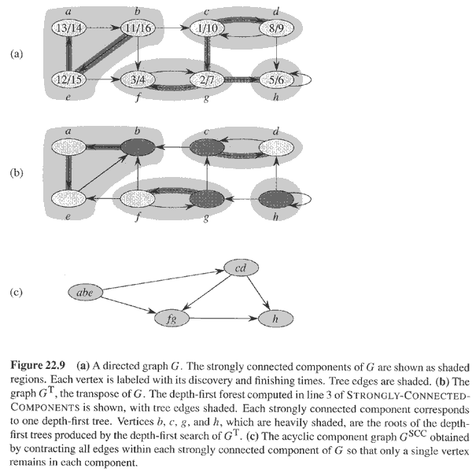
Example
Data Structure and Algorithm
Notes:
If there is a node not in a cycle but from whom there is path to you then it has to have higher finish time than yours.

Slide 14
What is SCC graph
Let C={C₁,C₂....,C_{n} } be the set of strongly connected components of G=(V,E).
The SCC graph is
G^{SCC} =(V^{SCC}, E^{SCC}) where V^{SCC}={v₁,v₂,....v_{n}} where each vertex v_{i} in V^{SCC} represents the strongly connected component C_{i} in C. There is a directed edge (v_{i}, v_{k}) in E^{SCC} if there is a directed edge (x,y) ∈ E such that x ∈ C_{i} and y ∈ C_{k}.
Input Graph
SCC Graph

Slide 15
Why does it work.
Consider the SCC graph.
The vertices inside a node of the SCC graph can be reached even if the edges of the original graph are reversed starting from any vertex among the vertices of a particular SCC.
Note that the SCC graph is acyclic. If there is a path from a node A to B in an acyclic graph then f(A)>f(B).
Since DFS is performed on the node with highest finish time in the graph with reversed edges; it can be observed that the DFS tree will be limited to one strongly connected component.
From the example above, one among the nodes {a,b,e} would have highest finish time. Infact f(abe)>f(cd)>f(fg)>f(h).
However, the dfs will reach all nodes within the SCC due to cycles that are unaffected by reversed edges. However, the DFS will not be able to leave the SCC due to the reversed edges across components.
All components are found on starting DFS on the node with hightest finish time among the unvisited nodes.

Slide 16
Questions
Let C={C₁,C₂....,C_{n} } be the set of strongly connected components of G=(V,E).
Let,
G^{SCC} =(V^{SCC}, E^{SCC}) where V^{SCC}={v₁,v₂,....v_{n}} where each vertex v_{i} in V^{SCC} represents the strongly connected component C_{i} in C. There is a directed edge (v_{i}, v_{k}) in E^{SCC} if there is a directed edge (x,y) ∈ E such that x ∈ C_{i} and y ∈ C_{k}.
Then, ((G^{T})^{SCC})^{T} = G^{SCC} where G^{T} denotes the transpose graph of G.
True/False ?

Slide 17
Consider a directed graph G=(V,E) where each node is initially colored white. What should be the minimum number of nodes that we should change to red such that for each white node v in G, there exists at least one red node r such that there is a directed path from r to v and v to r. Assume that for every node there is at least one other node it is reachable from and can reach to.

Slide 18
1. Consider a party where you would want to group people who should sit together at the same table such that at each table among any pair of people, one is known to the other either directly or through some sequence of people on that table. We would want to minimise the number of tables. Give an algorithm for each of the below scenarios
Case1: If guest g knows guest t then guest t knows guest g.
Case2: If guest g is known to guest t, it is not necessary that guest t be known to guest g.
2. Assume every pair of guest knows each other directly. Two guests who are on bad terms are not to be seated on the same table. What are the minimum number of tables required.

